Slide 1

Convolutional Neural Networks
Investigating local features.

Slide 2
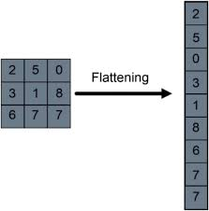
The Problem
Consider flattening the image into a 1D vector
An RGB Image of size 224 x 224
Number of features: 224 x 224 x 3 = 150528
Too many parameters
Require a lot of data
Do not respect spatial structure

Slide 3
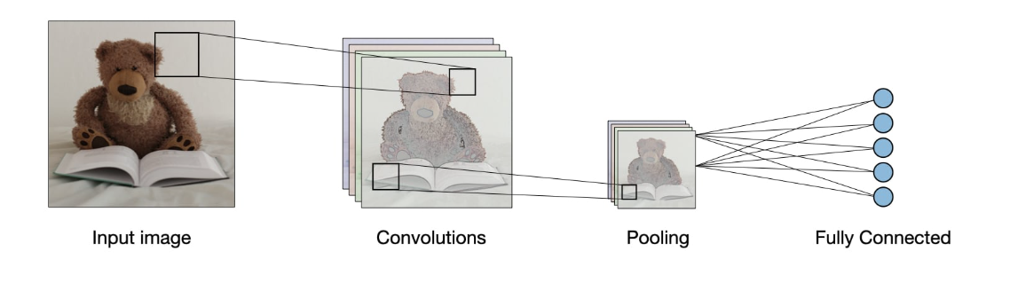
What is a Convolutional Neural Network
CNNs revolutionized image recognition using automated feature learning
Designed to respect the 2D structure of images
Loosely modeled after the visual cortex

Slide 4
The Kernel and Stride
A Kernel is a small matrix that acts as a feature detector for edges and textures
The same weights are used across the entire image
It computes the dot product at each position, outputting a feature map.
S(i, j) = (I * K)(i, j) = ∑∑ I(i*S+m, j*S+n)K(m, n).
The step the kernel takes as it slides over the image is called the Stride(S)
Output tensor dimension is 1 + (d_in - k)/stride

Slide 5
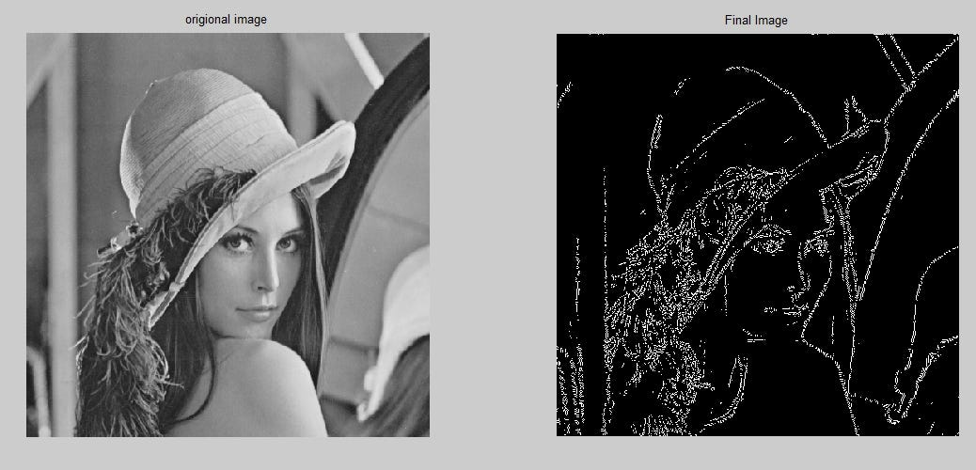
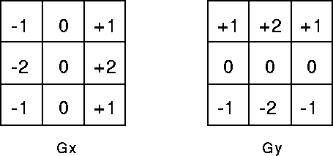
Classical Feature Detection Kernels (Pre-CNN Era)
Sobel Filters (Used for edge detection)

Slide 6
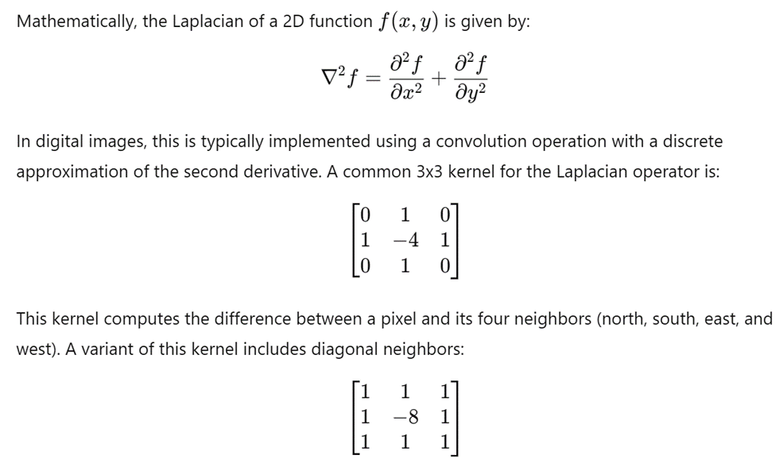
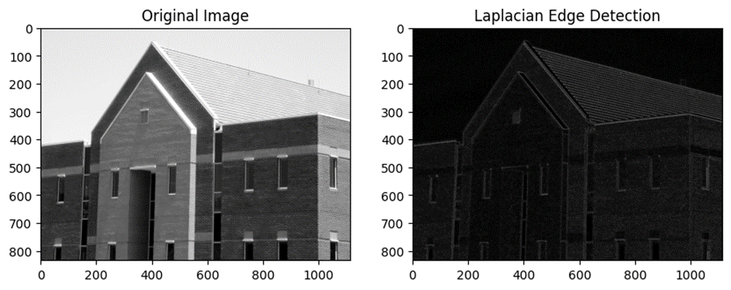
Classical Feature Detection Kernels (Pre-CNN Era)
Laplacian Filter(Second Order Edge)

Slide 7
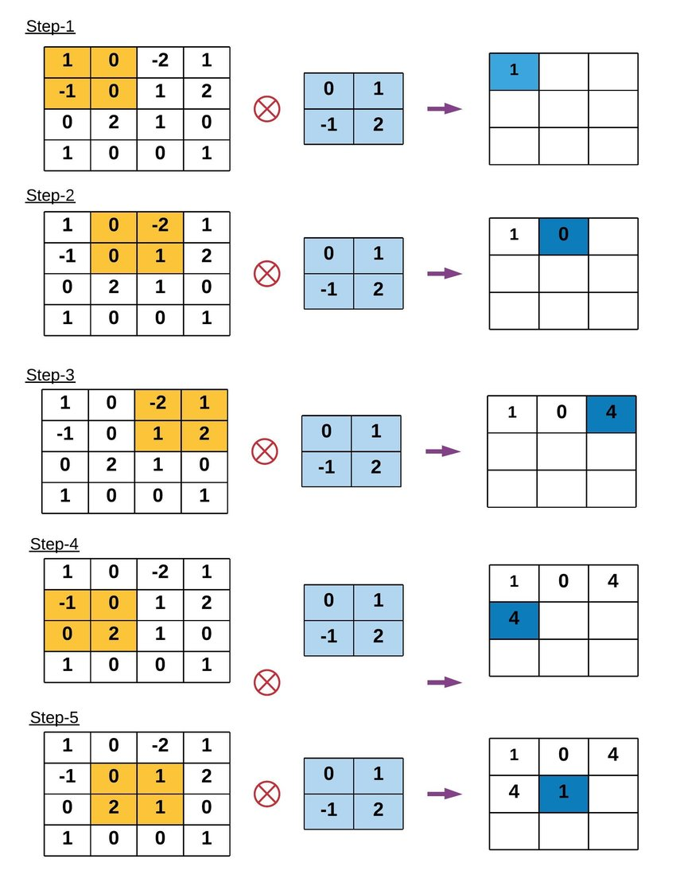
Core idea of convolution
Use small filters (kernels)
Slide over image
Multiply & sum
Produce feature map

Slide 8
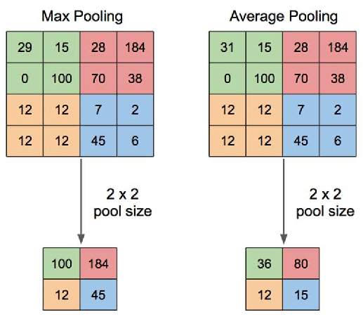
The Pooling Operation
Reduces the spatial dimensions of the feature maps
Translational Invariance
Fixed Operations
Max Pooling : Select the maximum value from a neighbourhood
Average Pooling: Select the average value from a neighbourhood

Slide 9
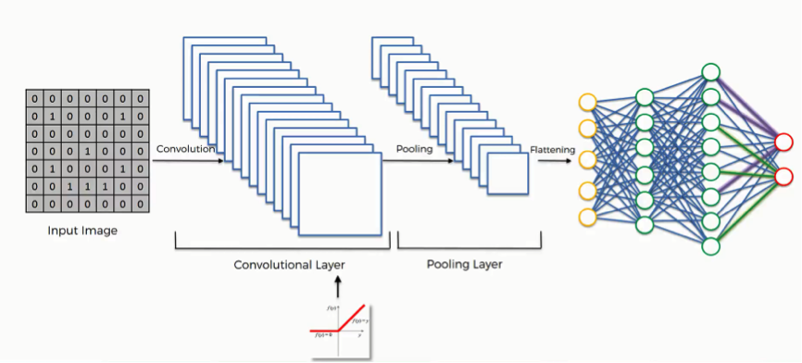
Fully connected layers
High level features are “Flattened” into a 1d vector
The final dense layers take the extracted features and perform classification
The final fully connected layer uses softmax to output a probability distribution

Slide 10
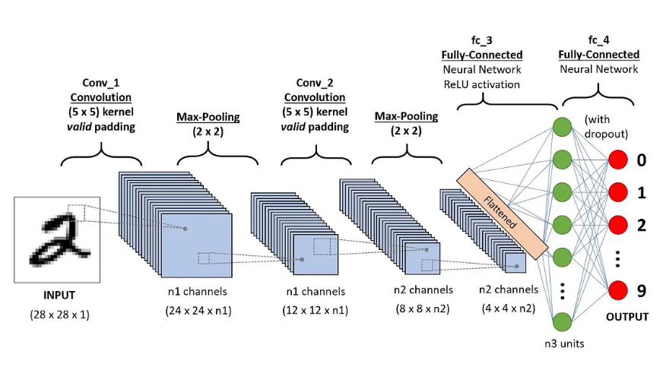
Typical CNN Architecture

Slide 11
Padding (Managing the Borders)
Output dimensions shrink after every convolution
Information at the edges gets lost
Padding adds extra layers around the edges, allowing the kernel to slide over edges
Every time a kernel(size K) is convolved, spatial dimension decreases

Slide 12
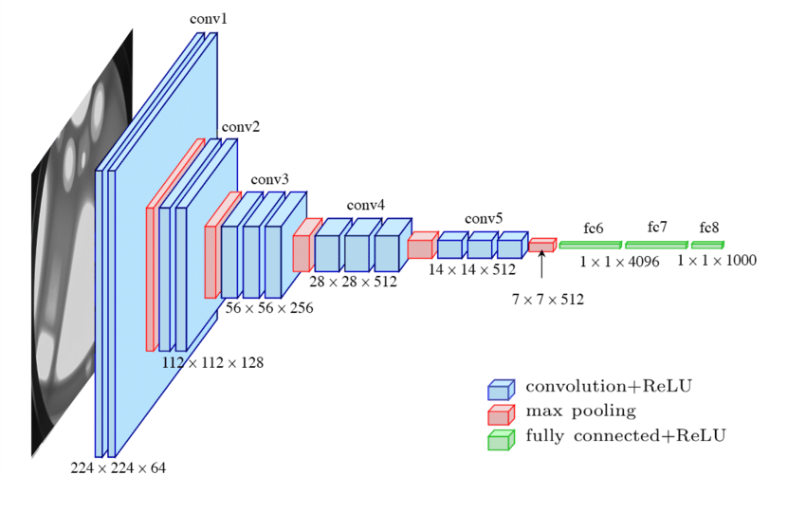
Typical CNN Architecture

Slide 13
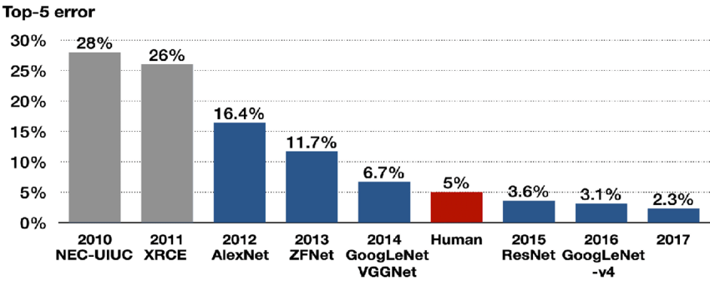
Architecture Timeline (ILSVRC)
LeNet-5(1998) : The pioneer for digit recognition using basic conv and pooling layers
AlexNet(2012): The big bang of deep learning. Popularized ReLU and dropout on massive networks
Resnet(2015): Solved the vanishing gradient problem using “Skip Connections”

Slide 14
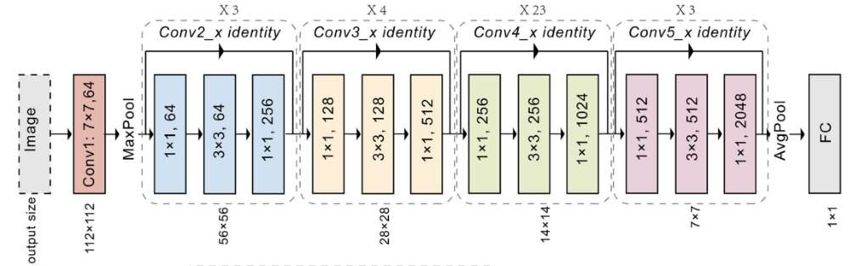
ResNets
Solved Vanishing gradients using skip connections
The concept of skip connections from here was adopted in many other places in DL.
Many variants that build on top of this exist e.g wide Resnets, densenets

Slide 15
Recurrent Neural Networks
Resolving Amnesia

Slide 16
The Goldfish Problem
Standard Feedforward Networks fail at sequences
They assume every input is fully independent
Once a prediction is made, their memory is wiped
They cannot understand grammar, predict stock trends, or follow a video

Slide 17
The Solution
We add memory!
The “Sticky Note” Architecture:
The network passes its previous state back to itself
The components:
xt : Current Input
ht : The “Sticky Note” (Memory/Hidden State)
yt : Prediction at this moment

Slide 18
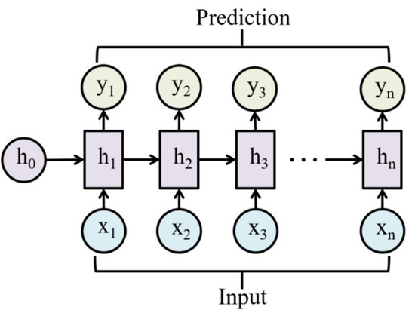
The Math Behind RNNs
The weights (W) are identical across all steps
This is for generalization
The Equation:
ht = tanh(Wxh * x(t) + Whh * h(t-1) + b)
Wxh * xt : What is happening right now
Whh * ht : What it remembers from previous steps
yt = softmax(Why * ht + b)
tanh : Squashes values between -1 and 1

Slide 19
The Goldfish is Back
Vanilla RNNs cannot handle long-term dependencies
Error signals must travel backward through every single time step
This is called Backpropagation Through Time (BPTT)
These signals get multiplied through every step.
Gradients grow to infinity and the model crashes(when |W|>1) (Exploding gradients)
Fix by gradient clipping
Gradients shrink to zero and the model forgets the past (Vanishing gradients)(when |W|<1)
Fix?

Slide 20
Long Short Term Memory Networks
Sequence learning with selective amnesia.

Slide 21
Smarter RNNs - LSTMs
Maintain two types of memory
Short term memory/hidden state : ht
Long term memory/cell state : Ct
Think of it like reading a book. After reading each page you decide what to keep remember long term and what to forget
Helps overcome explosive and vanishing gradients

Slide 22
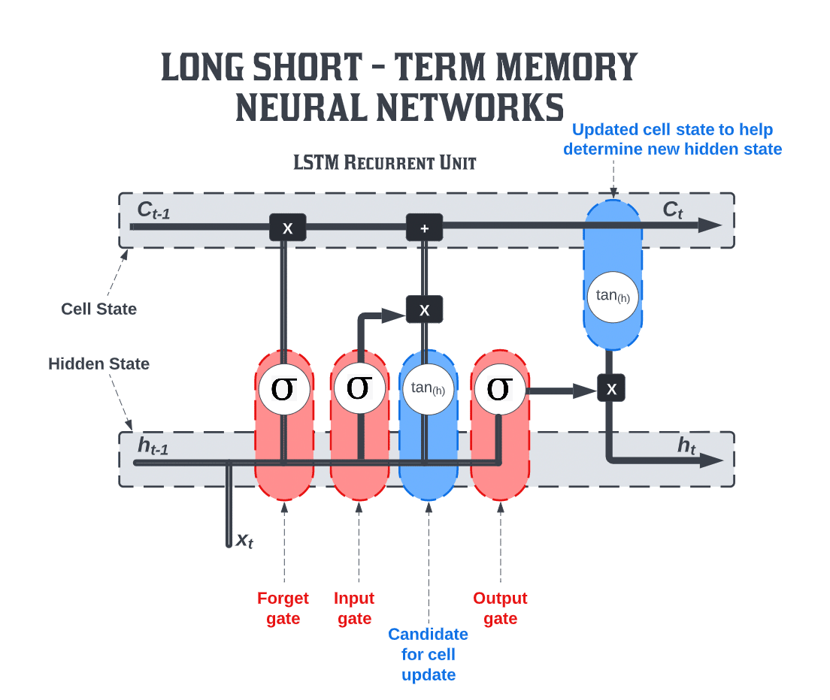
LSTM: Block overview
Each LSTM block contains:
Cell state
Hidden State
Forget Gate
Input Gate
Output Gate

Slide 23
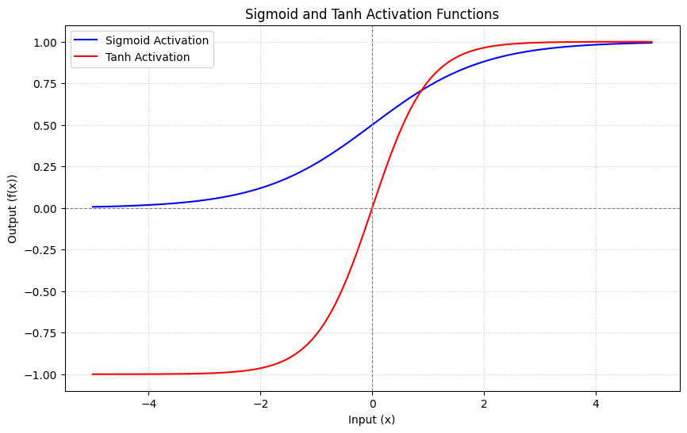
LSTM: Sigmoid and Tanh
Sigmoid:
Acts as a soft switch.
What % value to pass
Tanh:
Unlike sigmoid gives expressive values.
Richer representation than sigmoid

Slide 24
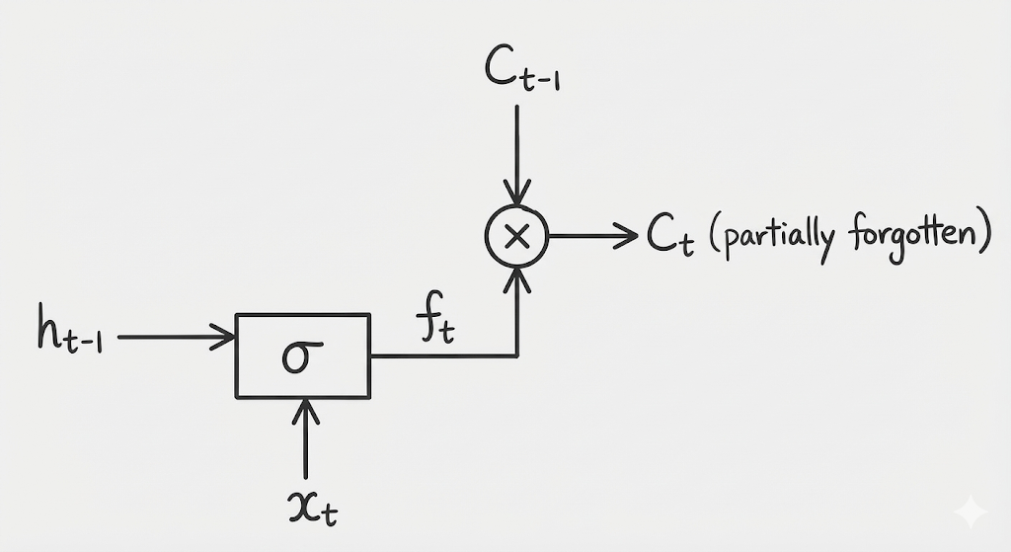
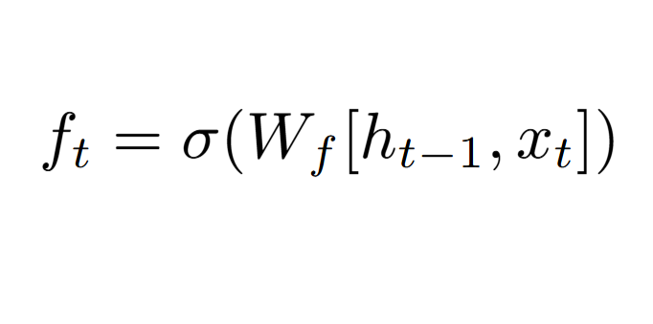
LSTM: Forget Gate
Decides which info is relevant
Formula:

Slide 25
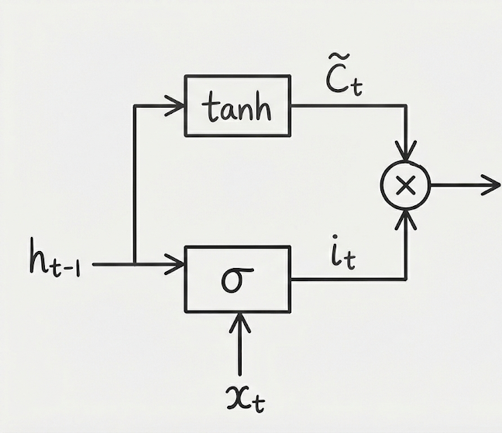
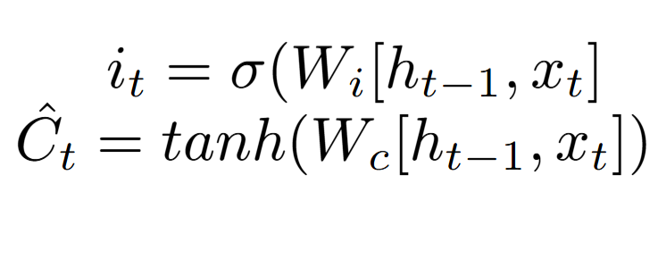
LSTM: Input Gate
What should we store.
Formula:
Second equation is candidate memory
First decides the strength of candidate memory

Slide 26
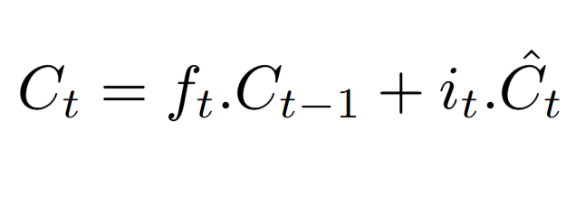
LSTM: Cell state Update
Memory Update = Keep + Add
Formula:
First term: Retained past
Second term: New info

Slide 27
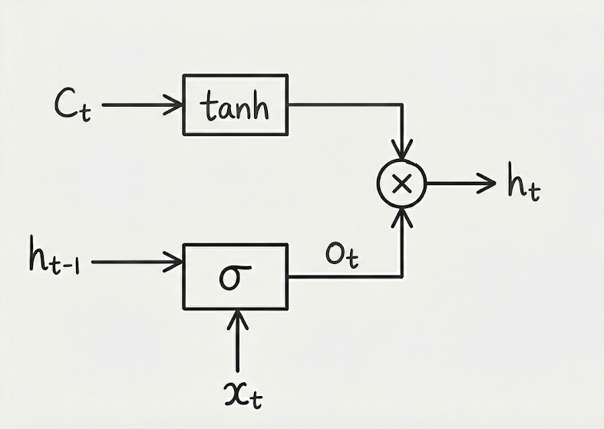
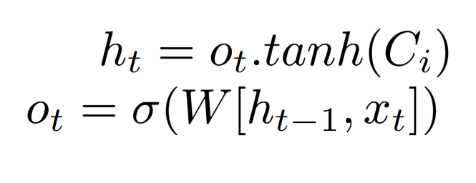
LSTM: Output Gate
Outputs hidden state ht.
Formula:

Slide 28
LSTM: Visualization
Sentence: i loved kgf movie when i first watched it then i started finding it overrated but after rewatching i enjoyed it again now i don't really care about it

Slide 29
Different Types of RNNs/LSTMs
Many-to-One
Sequence of inputs -> Final output
Example: Sentiment analysis
One-to-Many:
One input -> Sequence of outputs
Example: Image captioning
Many-to-Many(Synced):
Output at each step
Example: Video frame classification
Many-to-Many(Seq2Seq):
Read the whole sequence, then output
Example: Language Translation

